Slide 1
Defining the Strategic Plan November 1, 2023
Instructor: Leslie Robin , CNM, Senior Strategist lrobin@cnmsocal.org

Slide 2

Getting to Know You
In small groups:
Introduce yourself
Expectations

Slide 3

Expectations

Slide 4

Ground Rules
Be Present
Participate – interaction
Step up/back
Confidentiality - safe space
Adult learning – we all have content & experience to contribute
Learn from each other
Zoom protocol
Respect other opinions
Others ??

Slide 5
Intended Outcomes
Understand the components and steps of a strategic planning process and how the process can apply to your organization.
Appreciate the interrelationships between strategic planning, fund and resource development planning, and program evaluation & planning.
Develop your Plan to Do Planning.

Slide 6

Polls Your Strategic Planning Experience

Slide 7
Agenda
Defining Planning and Strategic Planning
Setting the Context - Breaking Down the Beginning of the Process
Setting the Direction
Environmental Scan
Creating the Plan
Logic Model
Wrap- up

Slide 8
Defining Planning and Strategic Planning

Slide 9

Why Plan?
Notes:
Create shared Vision
Define organization’s purpose
Establish realistic goals and objective
Create sense of ownership
Ensure effective use of all resources
Build a consensus
Bridge staff and board of directors
Solve major problems
Readiness
Why are we planning?
Identify specific issues to be addressed
Clarify roles in the process
Create a task force
Assess the current situation
Develop an information gathering plan

Slide 10
What is Strategy?
What is Strategy?
Strategy is a general plan to achieve one or more goals under conditions of uncertainty.
What is Organizational Strategy?
Specifies how an organization will allocate resources (fund, labor, inventory) to support goals, infrastructure, marketing, etc.
Notes:
Exercise
When was the last strategic decisions you made?
What was the last organizational strategy you made?
Who made that decision? Who was not in the room making the decision?
Strategic decisions are decisions that incorporate many factors such as:
The environment in which the organization operates
Organizational resources
Staff
The relationship between staff and resources

Slide 11
What is Strategy?
What is Strategic Decision?
Strategic decisions are decisions that incorporate many factors such as:
The environment in which the organization operates
Organizational resources
Staff
The relationship between staff and resources
Notes:
Exercise
When was the last strategic decisions you made?
What was the last organizational strategy you made?
Who made that decision? Who was not in the room making the decision?
Strategic decisions are decisions that incorporate many factors such as:
The environment in which the organization operates
Organizational resources
Staff
The relationship between staff and resources

Slide 12
What makes the plan strategic?
Strategic Plans are living documents with the flexibility to plan for uncertainty taking in account the 3 primary decisions an organization makes.​
Administrative Decisions
Operational Decisions
Strategic Decisions
Strategic Plan
Notes:
This is about thinking forward and going to the future, focused on where you want to be.
Strategic decisions are decisions that incorporate many factors such as:
The environment in which the organization operates
Organizational resources
Staff
The relationship between staff and resources
Strategic decisions are different from administrative and operational decisions. Administrative decisions are routine decisions which help or rather facilitate strategic decisions or operational decisions. Operational decisions are technical decisions which help execution of strategic decisions. To reduce cost is a strategic decision which is achieved through operational decision of reducing the number of employees and how we carry out these reductions will be administrative decision.

Slide 13

What is Strategic Planning?
What is Strategic Planning?
Strategic Planning
is a PROCESS
step back
take stock
create a future vision
identify goals
action plan
Notes:
…a systemic process through which an organization agrees on –
and builds commitment among key stakeholder to –
priorities which are essential to its mission and response to the operating environment.
Strategic Planning is a PROCESS
step back
take stock
create a future vision
identify goals
action plan

Slide 14
Planning Process
Self-Assessment
Preparation
Environmental Scan
(external & internal)
Analyze & Prioritize
Review
(Vision, Mission, Values)
Development of the Plan
Notes:
Task force is convened

Slide 15
Preplanning & Getting Ready
Monitoring & Refining
Clarifying of Mission & Vision
Approval & Implementation
Assessing the Environment
Developing an Action Plan & Budget
Identifying & Agreeing Upon Priority Issues
Formulating Goals & Objectives

Slide 16
Types of Plans
Strategic Plan
(overall direction)
Tactical or Annual Plan
overall activities, measurable outcomes, responsibilities
Project Plan
detailed activities, responsibilities, deliverables and targeted dates
Action Plan
short-range courses of action
Fund Development Plan
fundraising targets by type of revenue and source
Evaluation Plan
specifies plan to track progress of implementa-tion
Notes:
All these plans are in alignment with the strategic plan
Strategic plan: what it isn’t
ED, Board, and Staff eval should also be aligned as well.

Slide 17
What is the path?
#2
What you have accomplished?
#3
Where you are at now?
#4
How to you get there?
#1
Where do you want to be?

Slide 18
Setting the Context – Breaking Down the Beginning of the Process

Slide 19

Determining Readiness

Slide 20
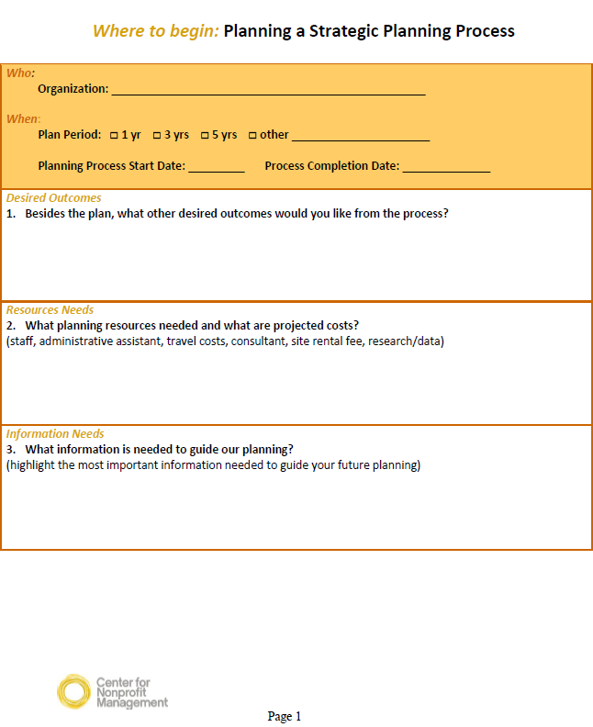
Plan to Plan Worksheet

Slide 21
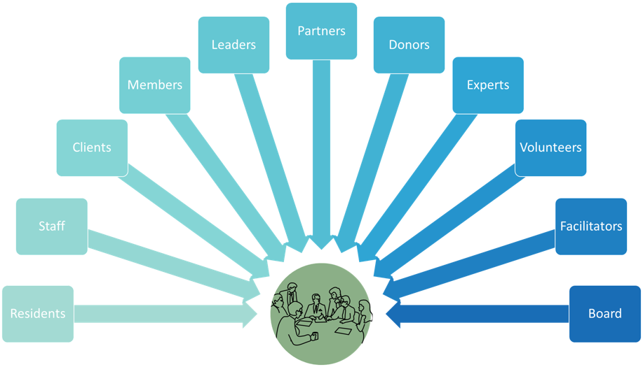
Meaningful Engagement

Slide 22
Setting the Direction

Slide 23
Defining Some Terms
Mission | “The impact your organization is going to create….”
Values | “What are your beliefs?”
Vision | “Change in the community”
Goals | “Short to long-term quantification of key goals”
Tactics/Initiatives | “An action to be taken to implement goals…”
Measures/Targets | “Measure of performance…”

Slide 24

Mission
Notes:
What is the purpose of the organization?
What is its business?
What are it’s fundamental values or beliefs that guide its daily interactions?
“What good, for whom,
at what cost"

Slide 25

Tweet your Mission
Your mission statement in 140 characters

Slide 26

Values We Believe . . .

Slide 27


Slide 28
Environmental Scan
Notes:
Environmental Scan:
Internal/External
Trends
Competitors/Partners
Policy/advocacy
Parent agency strategy/restrictions
Public perception
Agency and Public readiness

Slide 29
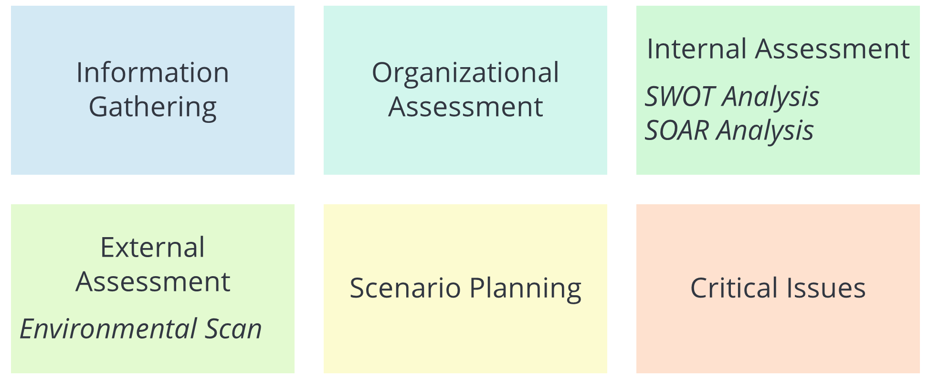
Assessing The Environment

Slide 30

What types of information will be helpful to information the Strategic Planning Process?

Slide 31
SWOT Analysis
Strengths | Weaknesses/Challenges
Opportunities | Threats
Internal
External

Slide 32
Creating the Plan

Slide 33
Typical Strategic Plan
Executive Summary
Planning Methodology & Acknowledge Participants
Mission and Vision
Current Situation
Internal
External
Major Priority Areas
Goals
SMARTIE Objectives
Action Plan – Tasks & Timeline
Budget – Multi-year
Revenue Plan – Multi-year
Evaluation throughout
Key Initiatives
Notes:
Accessibility is key on how the plan is accessible to folks
Core Elements:
Priorities, Goals, SMART Objectives
Key activities, benchmarks, assignments
Implementation Plans
Budget
Revenue
Annual Action Plans
Evaluation Plans

Slide 34
Major Priority Areas
Priorities and Goals
Internal
External
Objectives
Key Initiatives

Slide 35
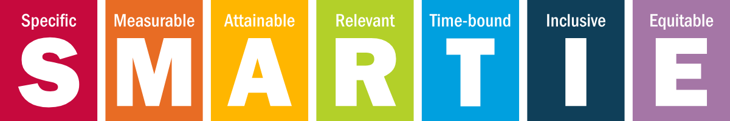
SMARTIE Objectives
All in one sentence

Slide 36

Team Conversation & Putting it on Paper
Team Conversations &
Putting it on Paper

Slide 37
Logic Model

Slide 38

What is a Logic Model?
A systematic and visual way to present and understand the relationship between your resources, activities, and results
Notes:
A logic model is a road map that illustrates the shared relationship among the resources, activities, outputs, outcomes, and impact for your program.
It depicts the relationship between your program’s activities and its intended effect.

Slide 39
Logic Model Template
PROCESS
OUTCOMES
Inputs
Activities
Outputs
Short-Term Outcomes
Long-Term Outcomes
Impact
Resources
Programs, services, and other activities
Direct products of program activities
Short-term and/or immediate benefits for participants during and after the activities
Long-term or longer-term benefits for participants during and after the activities
The change on a grander scale (systemic, state-level, socioeconomic shift, etc.)
Evaluation & Performance Measures
Notes:
Inputs
What resources do you have available?
Inputs are the resources that go into a program or intervention—what we invest. They include financial, personnel, and in-kind resources from any source. For example, inputs could include: Various funding sources for your program. Your partners. Staff time and technical assistance.
Activities
What programmatic activities are involved? What services are provided? What other actions are you taking as part of this effort?
Activities are events undertaken by the program or partners to produce desired outcomes—what we do. You could include a clear identification of “early” activities and “later” activities. Examples of activities include: Create a state-level partnership. Train health care partners and staff in clinical guidelines. Develop a community health communication campaign on signs and symptoms of stroke, and to call 9-1-1.
Outputs
What are the direct results of the program’s activities?
Outputs are the direct, tangible results of activities—what we get. These early work products often serve as documentation of progress. Examples include: State-level partnerships created. Health care professionals trained in clinical guidelines. Community health communication campaigns developed.
Outcomes
What direct benefits of the program? What are the desired results?
Outcomes are the desired results of the program—what we achieve. Describing outcomes as short, intermediate, or long term depends on the objective, the length of the program, and expectations of the program or intervention. What is identified as a long-term outcome for one program could be an intermediate outcome for another.
Short-term outcomes are the immediate effects of the program or intervention activities. They often focus on the knowledge and attitudes of the intended audience.
Intermediate outcomes are behavior, normative, and policy changes.
Long-term outcomes refer to the desired results of the program and can take years to accomplish.
Impact
Impacts refer to the ultimate impacts of the program. They could be achieved in a year or take 10 or more years to achieve. These may or may not be reflected in the logic model, depending on the purpose and audience of the logic model. A logic model that portrays an HDSP intervention may show expected long-term outcomes, such as a state-level system change, and impact, such as a population-wide reduction in death rate. Examples of impacts include: Decrease in the rate of death due to heart disease. Eliminate disparities in treatment for stroke between general and priority populations.
Assumptions
Assumptions are the beliefs we have about the program or intervention and the resources involved. Assumptions include the way we think the program will work—the "theory" we have used to develop the program or intervention. (See the subsequent section on Theories of Change.) Assumptions are based on research, best practices, past experience and common sense. The decisions we make about implementing a program or intervention are often based on our assumptions
Contextual Factors
Contextual Factors describe the environment in which the program exists and external factors that interact with and influence the program or intervention. These factors may influence implementation, participation, and the achievement of outcomes. Contextual factors are the conditions over which we have little or no control that affect success.
https://www.cdc.gov/dhdsp/docs/logic_model.pdf

Slide 40
Logic Model Sample
PROCESS
OUTCOMES
Inputs
Activities
Outputs
Short-Term Outcomes
Long-Term Outcomes
Impact
Money
Staff and volunteers
Facilities
Equipment/Supplies
Provide food and housing assistance to families experiencing homelessness
Provide job training
Educate public about signs of child abuse
Counsel pregnant women
Create mentoring relationships for youth
Direct products of program activities
# of classes taught
# of counseling sessions conducted
# of educational materials distributed
# of hours of service delivered
# of served
Increased skills and knowledge
Changed attitudes or values
Awareness of programs and services available
Confidence in navigating systems to access services
Housing stability
Financial stability
Reduce number of families experiencing homelessness in our community
Reduce number of families experiencing financial instability in our community
Increase community awareness of our services and the quality of such services
Evaluation & Performance Measures
Notes:
Inputs
What resources do you have available?
Inputs are the resources that go into a program or intervention—what we invest. They include financial, personnel, and in-kind resources from any source. For example, inputs could include: Various funding sources for your program. Your partners. Staff time and technical assistance.
Activities
What programmatic activities are involved? What services are provided? What other actions are you taking as part of this effort?
Activities are events undertaken by the program or partners to produce desired outcomes—what we do. You could include a clear identification of “early” activities and “later” activities. Examples of activities include: Create a state-level partnership. Train health care partners and staff in clinical guidelines. Develop a community health communication campaign on signs and symptoms of stroke, and to call 9-1-1.
Outputs
What are the direct results of the program’s activities?
Outputs are the direct, tangible results of activities—what we get. These early work products often serve as documentation of progress. Examples include: State-level partnerships created. Health care professionals trained in clinical guidelines. Community health communication campaigns developed.
Outcomes
What direct benefits of the program? What are the desired results?
Outcomes are the desired results of the program—what we achieve. Describing outcomes as short, intermediate, or long term depends on the objective, the length of the program, and expectations of the program or intervention. What is identified as a long-term outcome for one program could be an intermediate outcome for another.
Short-term outcomes are the immediate effects of the program or intervention activities. They often focus on the knowledge and attitudes of the intended audience.
Intermediate outcomes are behavior, normative, and policy changes.
Long-term outcomes refer to the desired results of the program and can take years to accomplish.
Impact
Impacts refer to the ultimate impacts of the program. They could be achieved in a year or take 10 or more years to achieve. These may or may not be reflected in the logic model, depending on the purpose and audience of the logic model. A logic model that portrays an HDSP intervention may show expected long-term outcomes, such as a state-level system change, and impact, such as a population-wide reduction in death rate. Examples of impacts include: Decrease in the rate of death due to heart disease. Eliminate disparities in treatment for stroke between general and priority populations.
Assumptions
Assumptions are the beliefs we have about the program or intervention and the resources involved. Assumptions include the way we think the program will work—the "theory" we have used to develop the program or intervention. (See the subsequent section on Theories of Change.) Assumptions are based on research, best practices, past experience and common sense. The decisions we make about implementing a program or intervention are often based on our assumptions
Contextual Factors
Contextual Factors describe the environment in which the program exists and external factors that interact with and influence the program or intervention. These factors may influence implementation, participation, and the achievement of outcomes. Contextual factors are the conditions over which we have little or no control that affect success.
https://www.cdc.gov/dhdsp/docs/logic_model.pdf

Slide 41
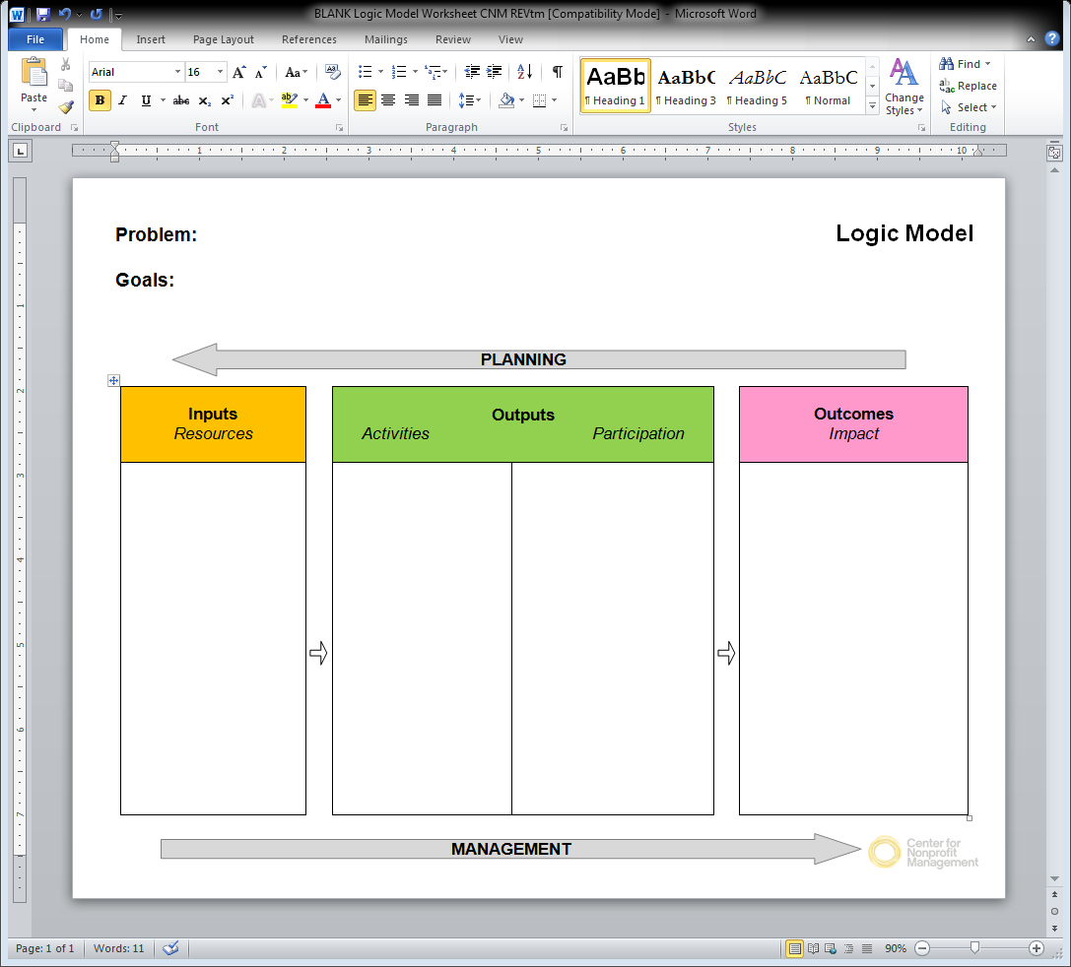

Slide 42
Wrap up and Reflection

Slide 43
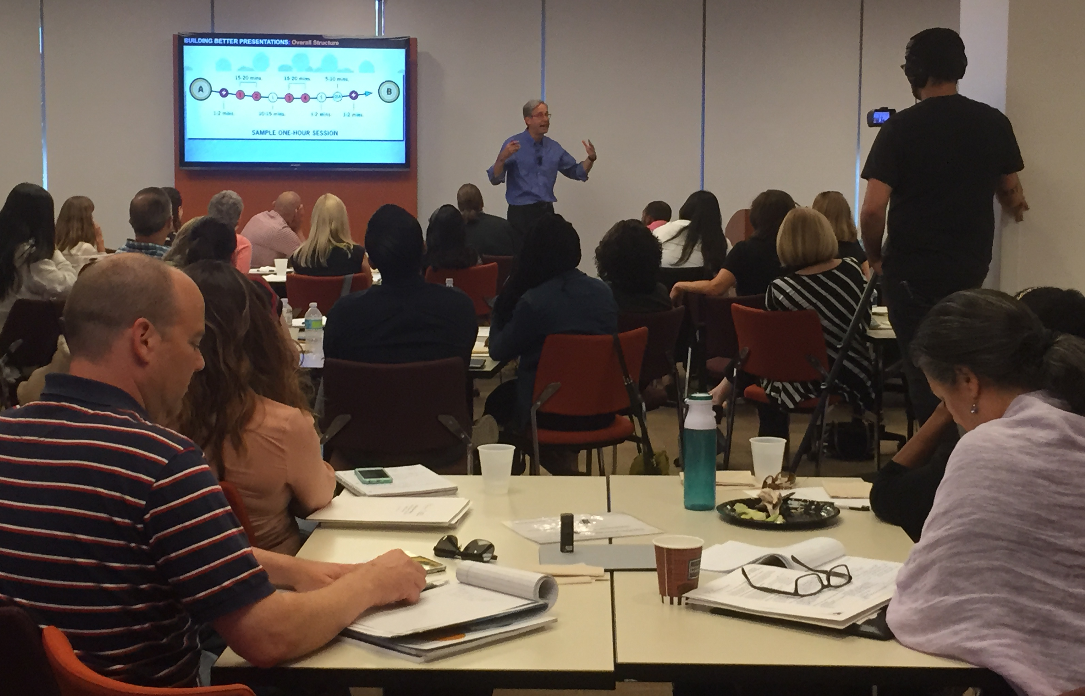
Considering a Consultant

Slide 44

Reflections from the session
What is one thing that you are taking away from today's session?

Slide 45

Leslie Robin Senior Strategist
lrobin@cnmsocal.org

